Slide 1
Back To JavaScript
getting the CoffeeScript out

Slide 2
State of things
We have a lot of CoffeeScript
(galileo-engine uses 227 CoffeeScript files)
We keep writing CoffeeScript
Interest in CoffeeScript declines

Slide 3
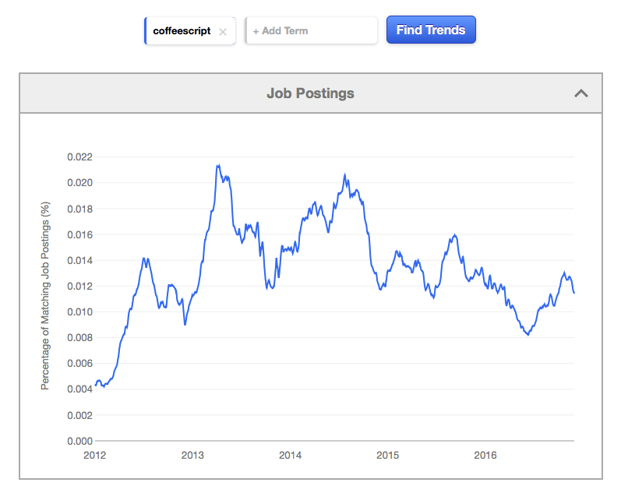

Slide 4
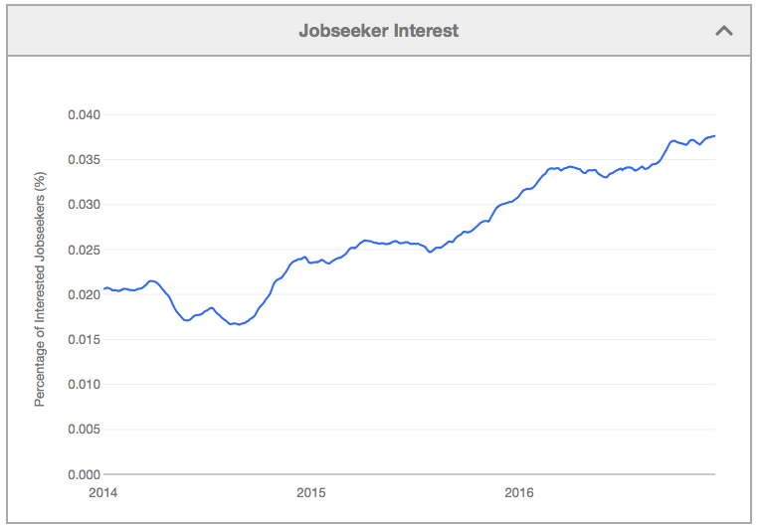
Meanwhile
ES2015 is in the wild
JavaScript is hot

Slide 5
We need a plan to get off CoffeeScript
How?
Read our code and re-write it by hand.
Use the CoffeeScript compiler and tweak the results.
Use decaffeinate.js and spend minimal time tweaking.
Use bulk-decaffeinate and let God sort ‘em out.

Slide 6
We need a plan to get off CoffeeScript
How?
Read our code and re-write it by hand.
Use the CoffeeScript compiler and tweak the results.
Look at CoffeeScript output
Might work well for Jasmine specs.
Use decaffeinate.js and spend minimal time tweaking.
Look at Decaffeinate output
Works pretty well! We would need to enhance the transpiled files a bit.
Use bulk-decaffeinate and let God sort ‘em out.
This thing is crazy, and is way too optimistic about decaffeinate’s output.

Slide 7
What to know about decaffeinate.js
Decaffeinate attempts to generate a decent ES2015 source file.
Uses real Class syntax
Uses esnext to handle conversion of var to let/const, arrow functions, destructuring, etc.
Has a multi-stage conversion process.
See it here: http://decaffeinate-project.org
More stages, more points of failure.
If decaffeinate fails, file an issue with the project!

Slide 8
My effort, a “kill-coffee” project
A set of grunt tasks not unlike the idea of bulk-decaffeinate, without the crazy git operations.
Reports any transpilation errors in fixme.html
Generates jsDoc, plato, and esdoc reports for immediate review.
Leaves only the CoffeeScript files it could not transpile, so we can run the task, make a fix, and run it again, until all the code has been converted.

Slide 9
kill-coffee recipe
Set of grunt tasks to automate conversion
Fix the CoffeeScript source on single file
Extract the AMD dependency data
Run decaffeinate on single file
If successful, delete the .coffee file and continue
Rebuild header and footer of JS file using AMD data
ES2015 imports/exports
Post-process, searching/replacing and moving lines
Include basic jsDoc annotation
Run jsDoc, esDoc, and Plato on converted JS source
Examine fixme.html for guidance on conversion issues

Slide 10
Demonstration using kill-coffee on some editors
Demo using button, spacer editor projects.
Kill-coffee runs from its own home directory
We supply paths names of source/spec directories
grunt -force -project=/Users/btremblay/src/galileo-button-editor -source=src -spec=spec
Set it up, and let it run.
Check for errors!
Read the docs
Does it build? (i doubt it)
Does it pass tests? (i doubt it)
Babel-Polyfill must be included!!!!
Added it to test-main.js template here.
Repeat until satisfactory

Slide 11
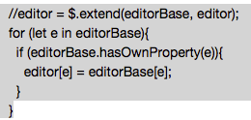
Issues I could remediate
Convert AMD to ES2015 modules
“initClass”, export default, infer return values
Backbone.listenTo was used, and this often puts the handler function in the wrong scope.
Those ES2015 modules we imported into CoffeeScript referenced the ‘.default’ export directly.
super() was used in constructors after other code
$.extend() mangles ES2015 class instances when used the way we are in CoffeeScript
use a gentler approach!

Slide 12
Things we have to fix manually
Imports are considered const
If we try to reassign them, they fail.
if (_ == null) { ({ _ } = window); }
Decaffeintate errors.
See fixme.html
Weird things, like callbacks inside “do”.
“Cannot automatically convert a subclass with a constructor that does not call super.”
Add the super().
Weird event binding.
Sometimes the best thing to do is rewrite.
Member functions of classes, even when bound, get passed into libraries that then use call/apply in a different scope!
Polyfills for ES5+ objects emitted by Babel!
Decaffeinate emits Array.from, Symbol.Iterator

Slide 13
It’s a work-in-progress
Decaffeinate will continue to improve
Tools like esnext and jscodeshift will improve
We’ll continue to learn
TODO: try https://lebab.io/try-it

Slide 14


what does the road map look like?
Editors
Layout editors
Engine
Yay!

Slide 15
thanks

